Slide 1
Time Series Modelling Case Study Rinny Wadhawan

Slide 2
INTRODUCTION
Data Introduction
The dataset contains sales of company from 2003 to 2017.
Monthly breakup of each year sales has been provided as “Sales” variable.
Objective
To predict the sales of next 3 years of a company through time series analysis using R.

Slide 3
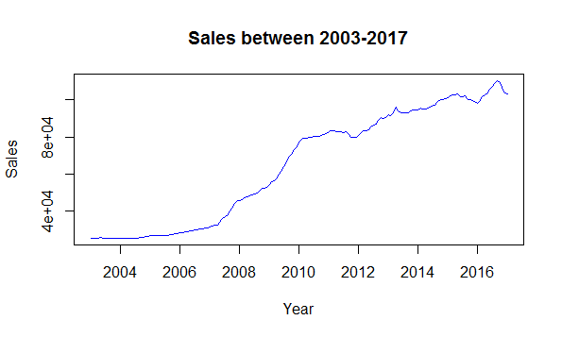
Testing Stationary
To check whether data is stationary is or non stationary ,we need to plot the data
As we can clearly see from
the graph that series is not
Stationary.
plot(TSdata,ylab="Sales", xlab="Year",main="Sales between 2003-2017",col="blue")

Slide 4
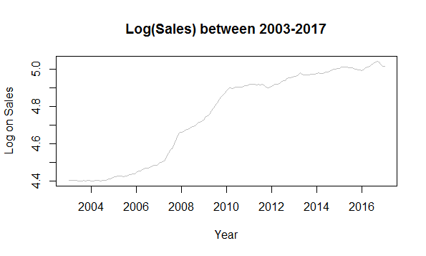
Log Transformation of Data
adf.test(data1,alternative="stationary")
since p=0.9691>0.05,which
shows that series is not
stationary
plot(log10(TSdata),ylab="Log on Sales",xlab="Year",main="Log(Sales) between 2003-2017",col="grey") data1<-log10(TSdata)

Slide 5
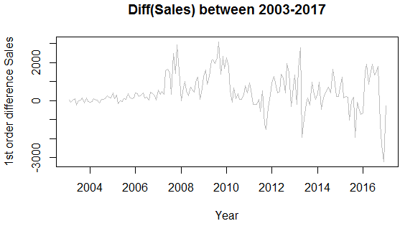
1st Order Differencing of data
adf.test(data2,alternative = "stationary")
#since p=0.08252>0.05,
which shows that series
is not stationary
plot(diff(TSdata),ylab="1st order difference Sales",xlab="Year",main="Diff(Sales) between 2003-2017",col="grey") data2<-diff(TSdata)

Slide 6
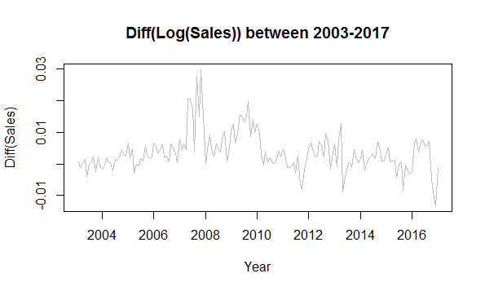
Differencing+ Log Transformation With Differencing=1
plot(diff(log10(TSdata),differences = 1),ylab="Diff(Sales)",xlab="Year",main="Diff(Log(Sales)) between 2003-2017",col="grey") LDTSdata=diff(log10(TSdata)) require(forecast)
adf.test(LDTSdata,alternative="stationary")
#since p=0.206>0.05,
which shows that series
is not stationary

Slide 7
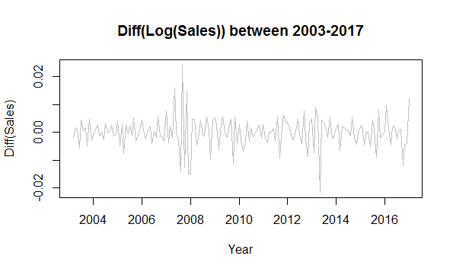
Differencing+ Log Transformation With Differencing=2
adf.test(LDTSdata1,alternative="stationary")
#So, with Log and 2 order of
differencing makes the series
stationary
plot(diff(log10(TSdata),differences = 2),ylab="Diff(Sales)",xlab="Year",main="Diff(Log(Sales)) between 2003-2017",col="grey") LDTSdata1=diff(log10(TSdata),differences = 2) require(forecast)

Slide 8
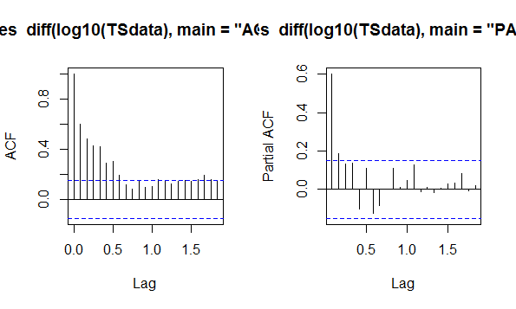
Identification of the Model
For identification of the model,we need to plot ACF And PACF
acf(diff(log10(TSdata),main="ACF plot"))
As we can see from ACF plot that order of moving average is expected to be 0.
This is because the last spike which is significantly outside the limits is at lag0.

Slide 9
Identification of the model Continued
Pacf(diff(log10(TSdata),main="PACF plot"))
As we can see from ACF plot that order of moving average is expected to be 0.
This is because the last spike which is significantly outside the limits is at lag0.
So we expect the model to be ARIMA(0,2,0)

Slide 10
Running the ARIMA model
ARIMAFit=arima((log10(TSdata)),c(0,2,0)) summary(ARIMAFit) arima(x = (log10(TSdata)), order = c(0, 2, 0)) sigma^2 estimated as 2.97e-05: log likelihood = 633.47, aic = -1264.95 Training set error measures: ME RMSE MAE MPE MAPE MASE Training set -3.454439e-05 0.005438496 0.003857603 -0.0006047645 0.08114804 0.7821591 ACF1 Training set -0.360661

Slide 11
Identification of best fit of ARIMA model
Series: log10(TSdata) ARIMA(0,2,1) Coefficients: ma1 -0.5619 s.e. 0.0698 sigma^2 estimated as 2.374e-05: log likelihood=653.32 AIC=-1302.64 AICc=-1302.57 BIC=-1296.41 Training set error measures: ME RMSE MAE MPE MAPE MASE Training set -9.343357e-05 0.004828667 0.003378004 -0.001612572 0.0708989 0.06977361 ACF1 Training set 0.03542726

Slide 12
Diagnostic Checking of the model
1.Values in first model are:
AIC=-1264.95
MAPE= 0.08114804
ME=-3.454439e-05
RMSE=0.005438496
MAE=0.003857603
MPE=-0.0006047645
And in second model
AIC=-1296.41
MAPE= 0.0708989
ME=-9.343357e-05
RMSE=0.004828667
MAE=0.003378004
MPE=-0.001612572
As we can all the values decreases in the second model ,which shows that it is best fit for the model

Slide 13
Final equation of model with ARIMA(0,2,1)
From the coefficients obtained ,the return equation can be written as:
Y(t)-Y(t-1)-Y(t-1)-Y(t-2)=-0.5619e(t-1)+et
So Y(t)=Y(t-2)+2Y(t-1)+0.5619e(t-1)+et

Slide 14
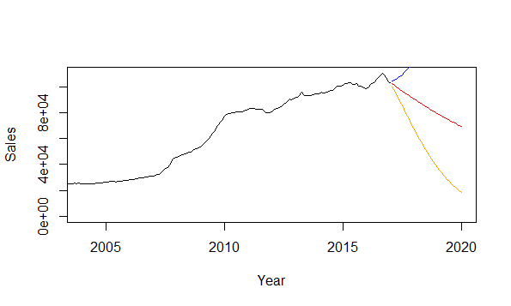
Forecasting of the Model
Following is a graphical presentation of observed and predicted sales of the company in red. Also, the range of expected error (i.e. +2 times standard deviation) is displayed with blue line and the range of expected error (i.e. -2 times standard deviation) is displayed with orange line .

Slide 15
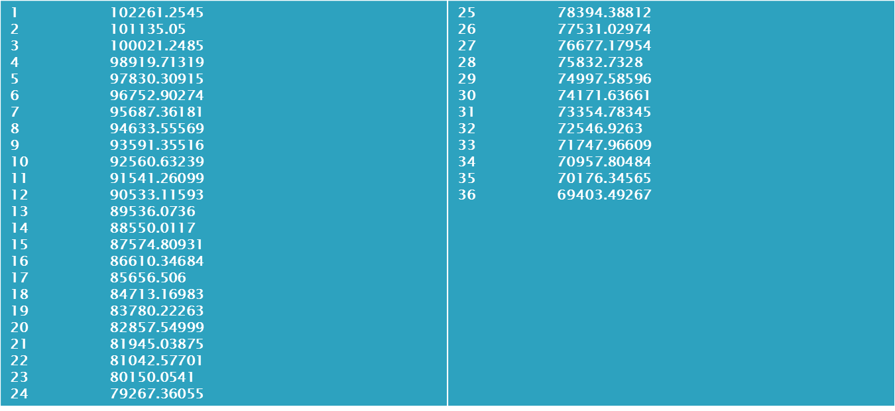
Predicted Sales of the company
Following are the predicted sales of the company for the next 3 years

Slide 16
Conclusion
In AR Process of ARIMA(0,2,1),the sales of next 3 years of company is not significantly related to past years sales of company.
In MA Process of ARIMA(0,2,1),the error term has significant coefficients for all last period error values.
This is the fact that has resulted in lower sales of company under forecasting for next 3 years.

Slide 17
Thank You

